Slide 1

Course Title: Software Development Fundamentals-2
DEPARTMENT
OF
COMPUTER SCIENCE AND ENGINEERING & INFORMATION TECHNOLOGY

Slide 2
Basic concept of Object Oriented Concept Attributes of Object Oriented Programming
Class
Object
Encapsulation and Data hiding
Data abstraction
Inheritance
Polymorphism
Dynamic Binding
Message Passing

Slide 3
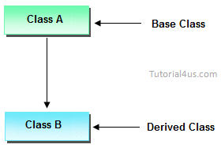
Inheritance
Inheritance is the process by which objects of one class acquire the properties of object of another class.
The capability of a class to derive properties and characteristics from another class is called Inheritance. Inheritance is one of the most important feature of Object Oriented Programming.
Super Class-----→
Sub Class: The class that inherits properties from another class is called Sub class or Derived Class. Super Class: The class whose properties are inherited by sub class is called Base Class or Super class.
Sub Class------→

Slide 4
Inheritance
Inheritance is a way to include functionalities of a parent class to a child class.
It doesn’t allow inheritance of private members from parent class.
It enhances code reusability.
Class A
Data
Functions
Class B
Data
Functions

Slide 5
Inheritance
Polymorphism enables to define many forms of a function and it is invoked based on the object calling it.
The functionality of a function differs according to the object that calls it.
Inheritance helps to implement polymorphism.
Class A
Data
Functions
Class B
Data
Functions

Slide 6
Advantages of inheritance
When a class inherits from another class, there are three benefits:
(1) You can reuse the methods and data of the existing class
(2) You can extend the existing class by adding new data and new methods
(3) You can modify the existing class by overloading its methods with your own implementations

Slide 7
Inheritance
Why and when to use inheritance?
Modes of Inheritance
Types of Inheritance

Slide 8
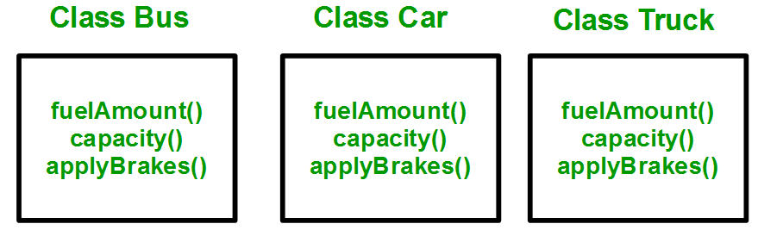
Why and when to use inheritance?
Consider a group of vehicles. You need to create classes for Bus, Car and Truck. The methods fuelAmount(), capacity(), applyBrakes() will be same for all of the three classes.
Without Inheritance

Slide 9
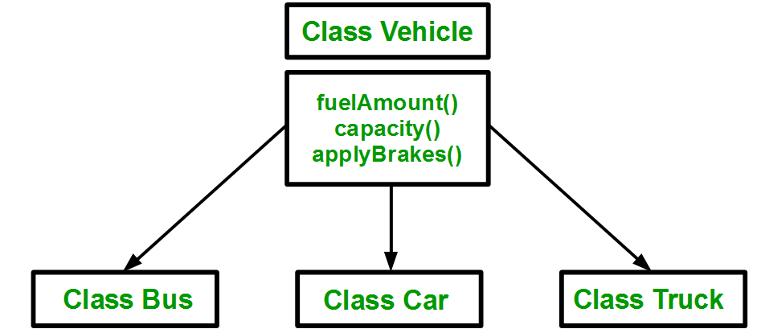
Why and when to use inheritance?
Code Reusability
With Inheritance

Slide 10
Modes of Inheritance
Public mode: If we derive a sub class from a public base class. Then the public member of the base class will become public in the derived class and protected members of the base class will become protected in derived class. Private members of the base class will never get inherited in sub class.
Protected mode: If we derive a sub class from a Protected base class. Then both public member and protected members of the base class will become protected in derived class. Private members of the base class will never get inherited in sub class.
Private mode: If we derive a sub class from a Private base class. Then both public member and protected members of the base class will become Private in derived class. Private members of the base class will never get inherited in sub class.

Slide 11
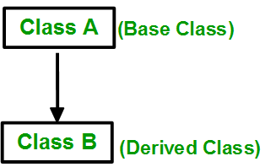
Types of Inheritance
Single Inheritance: In single inheritance, a class is allowed to inherit from only one class. i.e. one sub class is inherited by one base class only.

Slide 12
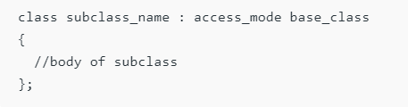
Types of Inheritance: Single Inheritance

Slide 13
Types of Inheritance: Single Inheritance
// sub class derived from two base classes
class Car:
public Vehicle{
};
// main function
int main()
{
// creating object of sub class will
// invoke the constructor of base classes
Car obj;
return 0;
}
// C++ program to explain
// Single inheritance
#include <iostream>
using namespace std;
// base class
class Vehicle {
public:
Vehicle()
{
cout << "This is a Vehicle" << endl;
}
};

Slide 14
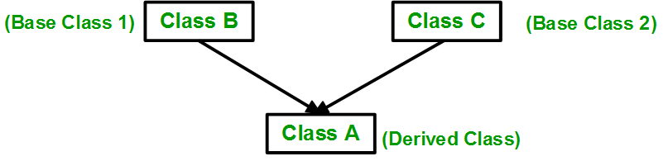
Types of Inheritance- Multiple Inheritance
Multiple Inheritance: Multiple Inheritance is a feature of C++ where a class can inherit from more than one classes. i.e one sub class is inherited from more than one base classes.

Slide 15
Multiple Inheritance Example Program
WingedAnimal()
{
cout << "Winged animal can flap." << endl;
}
};
class Bat: public Mammal, public WingedAnimal { };
int main()
{
Bat b1;
return 0;
}
Output
Mammals can give direct birth.
Winged animal can flap.
#include <iostream>
using namespace std;
class Mammal {
public:
Mammal()
{
cout << "Mammals can give direct birth." << endl;
}
};
class WingedAnimal {
public:

Slide 16
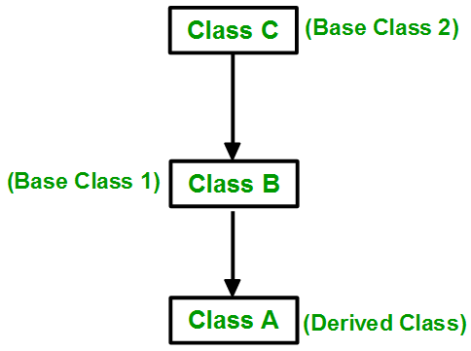
Types of Inheritance- Multilevel Inheritance
Multilevel Inheritance: In this type of inheritance, a derived class is created from another derived class.

Slide 17
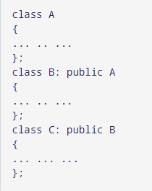
Types of Inheritance: Multilevel Inheritance
In C++ programming, not only you can derive a class from the base class but you can also derive a class from the derived class. This form of inheritance is known as multilevel inheritance.

Slide 18
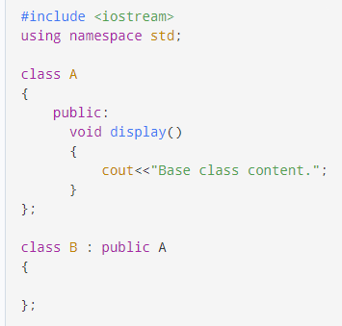
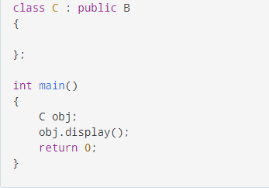
Multilevel Inheritance: Example

Slide 19
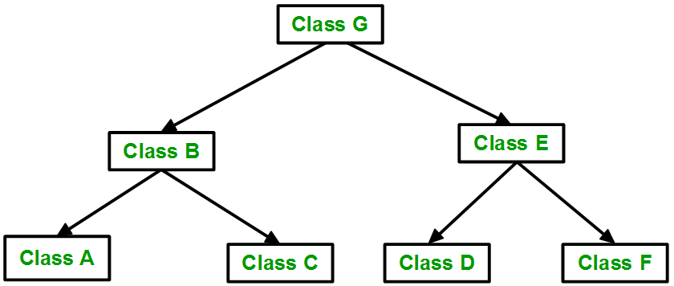
Types of Inheritance
Hierarchical Inheritance: In this type of inheritance, more than one sub class is inherited from a single base class. i.e. more than one derived class is created from a single base class.

Slide 20
Types of Inheritance
// C++ program to implement Hierarchical Inheritance
#include <iostream>
using namespace std;
class Vehicle
{
public:
Vehicle()
{
cout << "This is a Vehicle" << endl;
}
};
// first sub class
class Car: public Vehicle
{ };
// second sub class
class Bus: public Vehicle
{ };
// main function
int main()
{
// creating object of sub class will
// invoke the constructor of base class
Car obj1;
Bus obj2;
return 0;
}
Output:
This is a Vehicle
This is a Vehicl

Slide 21
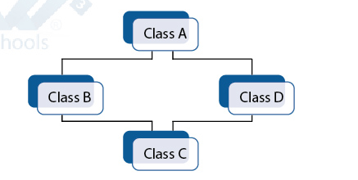
Types of Inheritance
Hybrid Inheritance: Hybrid Inheritance is implemented by combining more than one type of inheritance.

Slide 22
Access Specifier in Class Declaration
Class sample
{
Private:
//Visible to member function within its class but not in derived class
Protected:
//Visible to member function within its class and derived class
Public:
//visible to member functions within its class, derived classed and through object
};

Slide 23
Access Specifier
Access modifiers or Access Specifiers in a class are used to set the accessibility of the class members. That is, it sets some restrictions on the class members not to get directly accessed by the outside functions.
There are 3 types of access modifiers available in C++:
Public
Private
Protected

Slide 24
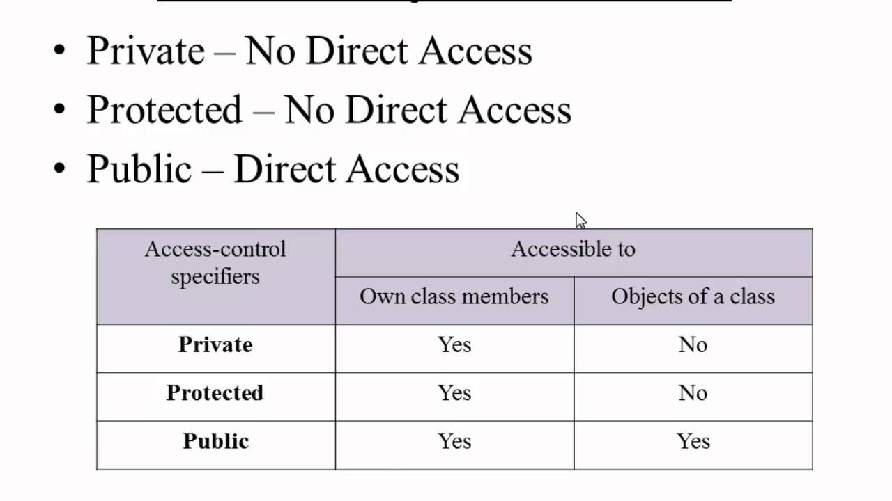
Access Specifier

Slide 25
INHERITANCE
HOW TO DECLARE DERIVED CLASS
Class Derived_class_name : Visiblity Mode Base_class_name
{
}
Public
Private
Protected

Slide 26
INHERITANCE
FOLLOWING ARE THE THREE POSSILBE STYLE OF DERIVATION
Public Derivative
class Derived_Class_name: public Base_class_name
{
}

Slide 27
INHERITANCE
FOLLOWING ARE THE THREE POSSILBE STYLE OF DERIVATION
Private Derivative
class Derived_Class_name: private Base_class_name
{
}

Slide 28
INHERITANCE
FOLLOWING ARE THE THREE POSSILBE STYLE OF DERIVATION
Protected Derivative
class Derived_Class_name: protected Base_class_name
{
}

Slide 29
INHERITANCE
Base class member | Derivation access level | Derived class member | User of derived class
Private | Private | Not accessible | Not accessible
 | Protected
 | Public
Public Protected | Private | Private | Not accessible
Protected | Public | Protected | Not accessible
 | Protected
Public | Protected | Protected | Not accessible
Public | Public | Public | Public

Slide 30
B
Not Inheritable----------------------
Private
-----------------Not Inheritable
Protected
Public
Class D2: private B
Class D1: public B
Private
Private
Protected
Protected
Public
Public
Class X: public D1:protected D2
Private
Protected
Public

Slide 31
B
Not Inheritable----------------------
Private
-----------------Not Inheritable
Protected
Public
Class D2: private B
Class D1: public B
Private
Private
Protected
Protected
Public
Public
Class X: public D1:protected D2
Private
Protected
Public

Slide 32
Class Derivation Constructors and Destructors
Constructors and destructors are not inherited
Each derived class should define its constructors/destructor
If no constructor is written=> hidden constructor is generated and will call the base default constructor for the inherited portion and then apply the default initialization for any additional data members
When a derived object is instantiated, memory is allocated for
Base object
Added parts
Initialization occurs in two stages:
the base class constructors are invoked to initialize the base objects
the derived class constructor is used to complete the task
The derived class constructor specifies appropriate base class constructor in the initialization list
If there is no constructor in base class, the compiler created default constructor used
If the base class is derived, the procedure is applied recursively

Slide 33
Constructor Rules for Derived Classes
The default constructor and the destructor of the base class are always called when a new object of a derived class is created or destroyed.
class A {
public:
A ( )
{cout<< “A:default”<<endl;}
A (int a)
{cout<<“A:parameter”<<endl;}
};
class B : public A
{
public:
B (int a)
{cout<<“B”<<endl;}
};
output:
A:default
B
B test(1);

Slide 34
Constructor Rules for Derived Classes
You can also specify an constructor of the base class other than the default constructor
DerivedClassCon ( derivedClass args ) : BaseClassCon ( baseClass args )
{ DerivedClass constructor body }
class A {
public:
A ( )
{cout<< “A:default”<<endl;}
A (int a)
{cout<<“A:parameter”<<endl;}
};
class C : public A {
public:
C (int a) : A(a)
{cout<<“C”<<endl;}
};
output:
A:parameter
C
C test(1);

Slide 35
Method Overriding
As we know, inheritance is a feature of OOP that allows us to create derived classes from a base class. The derived classes inherit features of the base class.
Suppose, the same function is defined in both the derived class and the based class. Now if we call this function using the object of the derived class, the function of the derived class is executed.
This is known as function overriding in C++. The function in derived class overrides the function in base class.

Slide 36
Method Overriding
To override a function you must have the same signature in child class. By signature I mean the data type and sequence of parameters. Here we don’t have any parameter in the parent function so we didn’t use any parameter in the child function.
In function overriding, the function in parent class is called the overridden function and function in child class is called overriding function.

Slide 37
Requirements for Overriding a Function
Inheritance should be there. Function overriding cannot be done within a class. For this we require a derived class and a base class.
Function that is redefined must have exactly the same declaration in both base and derived class, that means same name, same return type and same parameter list.

Slide 38
Method Overriding
Derived Function
// C++ program to demonstrate function overriding
#include <iostream>
using namespace std;
class Base {
public:
void print() {
cout << "Base Function" << endl;
}
};
class Derived : public Base {
public:
void print() {
cout << "Derived Function" << endl;
}
};
int main() {
Derived derived1;
derived1.print();
return 0;
}
Outpu: Derived Function

Slide 39
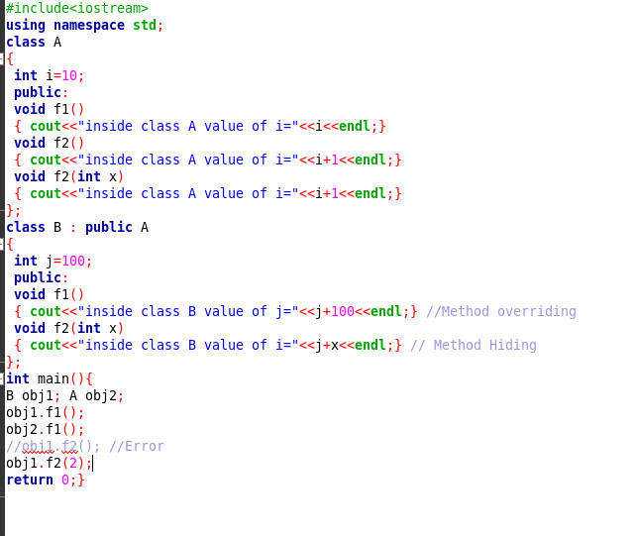

Slide 40
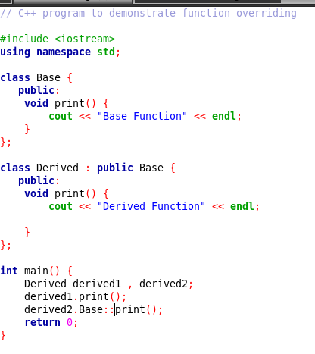

Slide 41
THANKS

